Slide 1
Optimizing knapsack using heuristics: A Comparative Study
Nitin Kankanala
Murali Ram Ravipati
Sai Vaishnavi Koganti

Slide 2
Motivation
The knapsack problem is a classic optimization problem where a set of items with different values and weights must be placed into a knapsack with a limited capacity to maximize the value of the selected items. However, finding the optimal solution to this problem can be computationally expensive and time-consuming, especially for large datasets.
Heuristics are particularly useful for solving the knapsack problem since they can quickly find near-optimal solutions that are close to the true optimum.

Slide 3
Problem Formulation
The problem formulation for optimizing knapsack involves:
Decision Variables: The decision variables are the items to be included in the knapsack.
Objective Function: The objective function is to maximize the value of the selected items subject to the capacity constraint of the knapsack.
Maximize: ∑(v_i * x_i)
3.Constraints: The constraints are defined by the capacity of the knapsack. ∑(w_i * x_i) ≤ C
Where w_i is the weight of item i and C is the capacity of the knapsack.

Slide 4
Various algorithms
Genetic Algorithm,
Tabu Search,
Scatter Search,
Local Search.

Slide 5
Genetic Algorithm
In the context of the knapsack problem, genetic algorithms work by evolving a population of candidate solutions over multiple generations. Each candidate solution represents a potential selection of items to be included in the knapsack.
The genetic algorithm is an effective approach for solving the knapsack problem because it can quickly generate a diverse set of candidate solutions and iteratively improve them over multiple generations.

Slide 6
Steps in Genetic Algorithm
Initialization
Fitness Evaluation
Selection
Crossover
Mutation
Evolve

Slide 7
Parameters to change
Genetic algorithm:
Population size
Mutation rate
Crossover rate

Slide 8
Tabu Search
Tabu search is effective for solving the knapsack problem because it can efficiently explore the search space by focusing on the most promising moves and avoiding revisiting the same solutions. Additionally, the algorithm can escape local optima by periodically diversifying the search. However, the effectiveness of the algorithm depends on the choice of the tabu list size and the frequency of diversification. Also, like most local search algorithms, Tabu search can get stuck in suboptimal solutions if the initial solution is not close to the optimal solution.

Slide 9
Steps in Tabu Search
Initialization
Neighborhood Search
Tabu Search
Diversification
Termination

Slide 10
Parameters to change
Tabu search:
Tabu tenure (the length of time that a move is forbidden after it has been made)
Number of iterations
Size of the neighborhood (number of neighboring solutions to consider)

Slide 11
Local Search
Local search is a metaheuristic algorithm that iteratively improves a candidate solution by exploring the neighborhood of the solution and selecting the best move that improves the objective function value. In the context of the knapsack problem, local search algorithms work by iteratively modifying a candidate solution by adding or removing items from the knapsack until a satisfactory solution is found.

Slide 12
Steps in Local Search
Initialization
Neighborhood Search
Local Search
Termination

Slide 13
Parameters to change
Local search:
Number of iterations
Size of the neighborhood
Stopping criteria (e.g., stop when there is no improvement after a certain number of iterations)

Slide 14
Scatter Search
Scatter search is a population-based metaheuristic algorithm that uses a combination of constructive and improvement procedures to generate a diverse set of candidate solutions for a given optimization problem. The algorithm works by iteratively combining promising solutions from different subsets of the population to generate new solutions and refining them through a local search procedure.

Slide 15
Steps for Scatter Search
Initialization
Improvement
Reference Set Generation
Subset Generation
Solution Combination
Improvement
Diversification
Termination

Slide 16
Parameters to change
Scatter search:
Size of the reference set (number of solutions in the initial set)
Size of the subproblems (number of solutions to combine in each iteration)
Number of iterations
Selection criteria (e.g., use a diversity metric to select solutions for the next iteration)

Slide 17
Data Set
We investigate how the algorithm performance varies with problem size and capacity constraints.
The performance of four optimization algorithms for solving the knapsack problem on three different types of problem instances: uncorrelated data instances, weakly correlated instances, and strongly correlated instances.

Slide 18
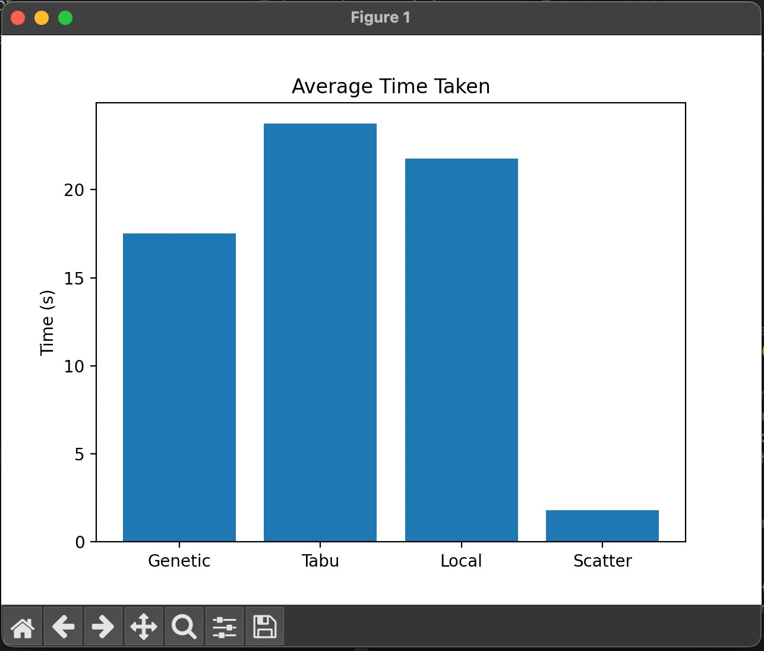
Performance measures
Quality of solution,
Execution Time,
Objective value comparison,
Convergence Speed,
Approximation ratio.

Slide 19
Conclusion
In conclusion, the choice of metaheuristic approach depends on the characteristics of the problem instance being solved. Future work could investigate the performance of these algorithms on other types of problem instances or explore hybrid approaches that combine the strengths of multiple algorithms.
We have developed code for the instance generation with a 30-70% correlation and observed that our code is not able to find optimal values as the approach was too stochastic. So we depended on some existing datasets and now are comparing them.

Slide 20
Thank you

